Slide 1
Data Types

Slide 2
Agenda
Comments
Data Types
More About Numbers
More About Strings

Slide 3
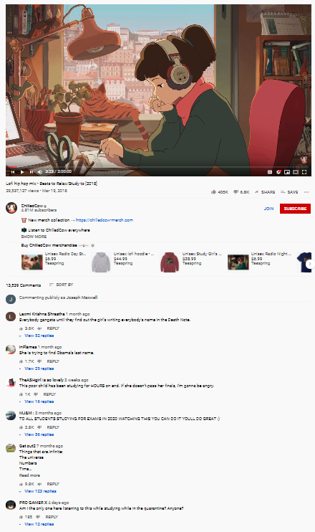
comments
Notes:
Comments in code are not exactly like YouTube comments, but they kind of are.

Slide 4
Comments in code
In a programming language, comments are any pieces of code that the computer ignores
In JavaScript, any line that starts with // is a comment, and will be ignored
Developers can also make multi-line comments using /* and */
Everything between is ignored
Comments are usually color coded with green or grey

Slide 5
Comments Example
// alert("comment");
alert("not a comment");
/*
anything can go here
alert("comment again");
*/
What will be displayed?
not a comment
(and nothing else!)
Notes:
Ask the students what the user will see if this code is run..
In this program, the user will see “not a comment” and no other messages.

Slide 6
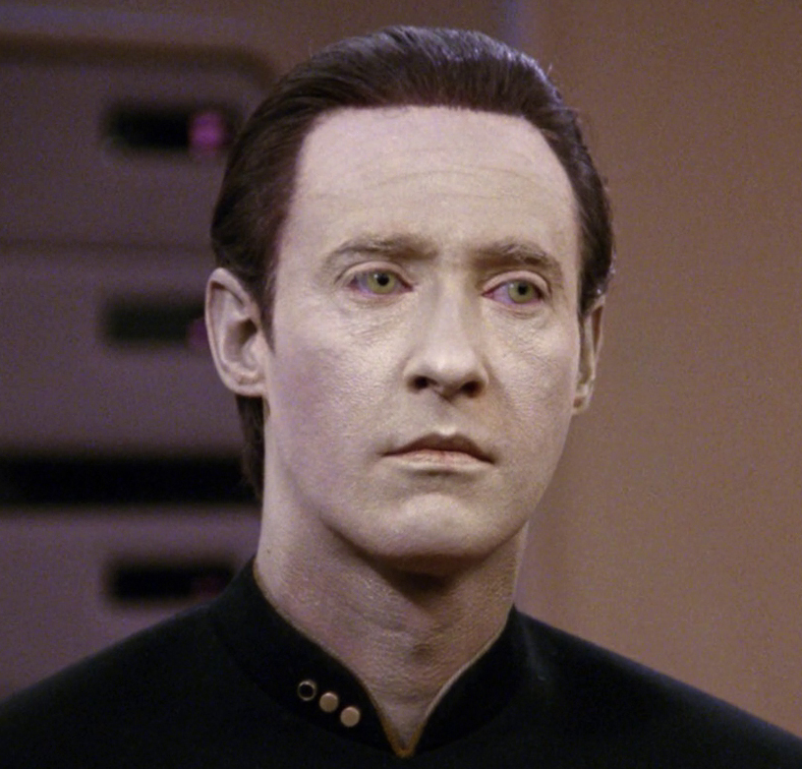
Data types
Notes:
Students probably will not understand the reference to Data from Star Trek – he was an android and chief operations officer of the Enterprise.

Slide 7
Data types
What types of data does a computer store?
Two basic data types:
String – A block of text, like "Hello, friend"
Number – A number, like 8
Notice the quotes:
Strings are what go into alerts and prompts!
Notes:
Ask the students to think of types of data the computer stores.
For now, we will be considering only two data types: strings and numbers.
Students should know what numbers are, but what about strings?

Slide 8
Mini-quiz: Name that data type!
19
Notes:
For this section, go around the room and ask the students to name the data type
number

Slide 9
Mini-quiz: Name that data type!
“Message”
Notes:
For this section, go around the room and ask the students to name the data type
string

Slide 10
Mini-quiz: Name that data type!
“11.3”
Notes:
For this section, go around the room and ask the students to name the data type
string

Slide 11
Mini-quiz: Name that data type!
10.900
Notes:
For this section, go around the room and ask the students to name the data type
number

Slide 12
Mini-quiz: Name that data type!
“Number”
Notes:
For this section, go around the room and ask the students to name the data type
string

Slide 13
Mini-quiz: Name that data type!
let name = "Bob";
Notes:
Looking for the data type of the variable name
string

Slide 14
Mini-quiz: Name that data type!
let name = 8;
Notes:
Looking for the data type of the variable name
number

Slide 15
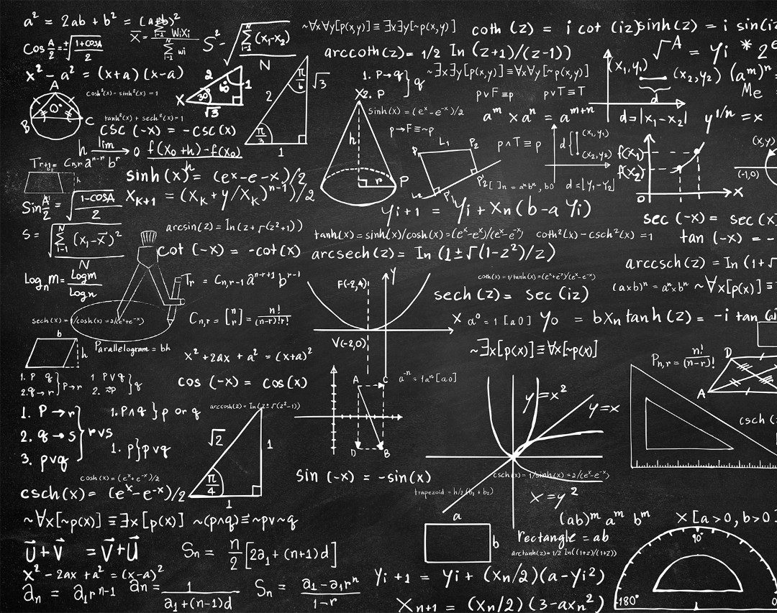
More about numbers: Math

Slide 16

Arithmetic operators
Addition: 4 + 5
Subtraction: 14 - 5
Multiplication: 3 * 3
Division: 18 / 2
Notes:
Ask the students what the values of each of these is

Slide 17
Arithmetic operators - variables
let x = 14 / 2;
let y = x + 2;
let z = 22 + 6 / 2;
Notes:
Ask the students what the values of each of these is
X = 7
Y = 9
Z = 25

Slide 18
Converting a string to a number
Input from the user using prompt will be in the form of a string
To do any math, we need to make it a number
We use Number() to convert the string
let input = prompt("How old are you?");
let age = Number(input);
Notes:
It is necessary to convert a string to number to be able to do math with it.

Slide 19
String to number example
https://jsfiddle.net/m4gndwv0/
Notes:
For this Repl – see what happens if you do NOT convert the string to a number. Change “let ageNumber = Number(age)” to “let ageNumber = age” and see what happens…
Instead of doing the addition, it should append “1” to the end of the number. So, age 14 -> you are almost 141

Slide 20

More about Strings

Slide 21
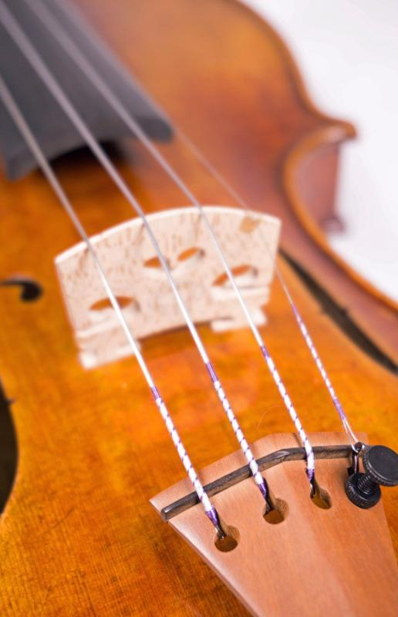
Strings – The things in alerts and prompts
Strings are a sequence of characters
To create a string, place quotes ("") around text
Strings are used to send/receive messages
alert("I am a string!");
let name = prompt("What is your name?");
Notes:
Note that the things within the double quotes are strings. The variable is also a string.

Slide 22
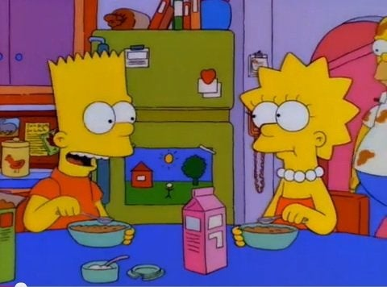
Adding Strings Together – concatenation
+
Which operator can add two strings together?
alert("Mabel" + "is my best friend");
let name = "Mabel";
let message = "I says to " + name + ", I says";
What’s the message?
Mabelis my best friend
It works for variables too, and multiple values can be chained together!
What’s the message?
I says to Mabel, I says
Notes:
Strings can be added together in what is called “concatenation”
Ask the students which operator does this – it’s the plus operator
Show basic example – NOTICE THE LACK OF SPACE
Ask students what it should say
It also works with variables and multiple items
Ask students what it should say

Slide 23
Questions?

